Slide 1


The Sounds of Language
An exploration of Phonetics, Articulation, and the hidden mechanics of human speech.

Slide 2






INTRO QUIZ
English has 26 letters... but how many sounds does it have?
(This mismatch is why we need Phonetics!)

Slide 3





The Analytical Framework Phonetics
Phonetics is the general study of speech sound characteristics. It has three main branches:
Articulatory
How sounds are made (mouth, tongue, lungs).
Acoustic
The physical properties of sound waves.
Auditory
How we perceive sounds via the ear.

Slide 4



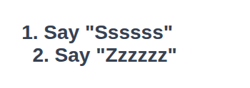
PHYSICAL CHALLENGE
The "Throat Touch" Test
Place your fingers gently on your Adam's apple.
(Snake)
(Bee)
Can you feel the difference?

Slide 5



Voiced vs. Voiceless The Mechanics
It's all in the Larynx
The vibration you felt comes from the vocal folds (vocal cords).
Voiceless (Open)
Folds are spread apart. Air passes clearly. Examples: [s], [f], [t], [k]
Voiced (Vibrating)
Folds are drawn together. Air pushes through. Examples: [z], [v], [d], [g]

Slide 6



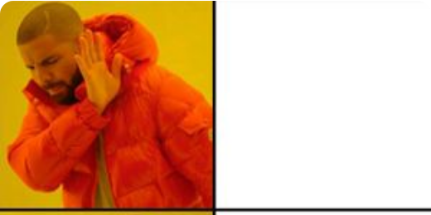

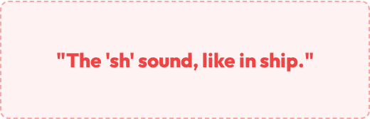
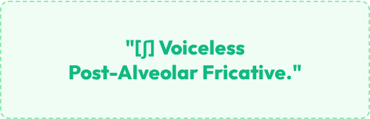
Why we need the IPA...

Slide 7



ARTICULATION MAP
Where is your tongue?
Say these three words and freeze your tongue.
POP
TOT
KICK
(Lips?)
(Teeth?)
(Back?)

Slide 8
Place of Articulation The Map
We classify consonants based on where the air constriction happens in the vocal tract.
Lips: Bilabials
Teeth: Dentals & Labiodentals
Ridge: Alveolars
Roof: Palatals
Back: Velars

Slide 9



The Front Lips & Teeth
Bilabials
Labiodentals
Dentals
Using both lips.
Upper teeth + Lower lip.
Tongue tip behind/between teeth.
[p] Pop [b] Bob [m] Mom [w] Wet
[f] Fat [v] Vat
[θ] Thin (Theta) [ð] Thus (Eth)

Slide 10


The Middle Ridge & Roof
Alveolars
Palatals
Tongue tip touches the Alveolar Ridge (bumpy part behind top teeth).
Tongue and the hard Palate (roof of mouth).
[ʃ] Ship
[ʒ] Casual
[t] Top
[d] Dog
[ʧ] Chip
[ʤ] Gem
[s] Sit
[z] Zoo
[j] Yet
[n] Nut
[l] Lap

Slide 11




The Back Velars & Glottals
Velars
Glottals
Back of tongue touches Velum (Soft Palate).
Space between vocal folds.
[h] Hat
[k] Cat, Kick
Air passes through without active tongue use.
These are the furthest back sounds in English.
[g] Gun
[ŋ] Bang (Angma)
*Note: No [g] sound in "ringing"

Slide 12
Consonant Summary The Big Picture
Place | Voiceless | Voiced | Example Articulators
Bilabials | [p] | [b], [m], [w] | Both lips
Labiodentals | [f] | [v] | Upper teeth + Lower lip
Dentals | [θ] (thin) | [ð] (then) | Tongue tip + Upper teeth
Alveolars | [t], [s] | [d], [z], [n], [l], [r] | Tongue tip + Alveolar ridge
Palatals | [ʃ], [ʧ] | [ʒ], [ʤ], [j] | Tongue + Palate
Velars | [k] | [g], [ŋ] | Back tongue + Velum
Glottals | [h] | - | Vocal folds

Slide 13



Image Sources
https://en.meming.world/images/en/thumb/0/07/Drakeposting.jpg/300px-Drakeposting.jpg
Source: en.meming.world
https://ih1.redbubble.net/image.3268556993.1909/bg,f8f8f8-flat,750x,075,f-pad,750x1000,f8f8f8.u1.jpg
Source: www.redbubble.com

